Slide 1

Tabular Editor
C# Automation
Advanced Scripting
Shrikesh Pattni

Slide 2
The Process
Tabular
Editor
Power BI
Advanced
Scripting
Execute
Shrikesh Pattni

Slide 3
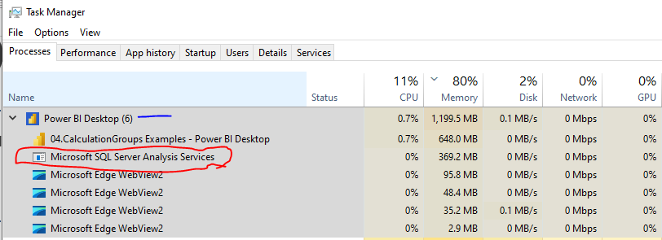
What is (TOM) Architecture
Server
TOM – Tabular Object Modelling
Database
Tabular Model
Power BI
Data Source
Tables
Relationships
Perspectives
Culture
Role
Annotations
Model.BIM File (source: Framework built based on Microsoft docs)
Shrikesh Pattni

Slide 4
Productivity Levels
Why Tabular
Editor
Extremely fast automation
Automate tasks and reuse scripts
Metadata only operations
No wastage of time
DAX bulk updates
Multi-select/drag and drop
Focus on what the “value” is
Write Once>Copy>Paste>UI editor>Run
MAGIC!!
50% Line
Power BI
Tabular Editor
Note: Above is author subjective views, based on experiences
Shrikesh Pattni

Slide 5
Enterprise Deployments
Why
Tabular Editor
Save to folder functionality of TOM
Extract a Model.BIM (semantic data)
Model.BIM allows for CI/CD automation
Translate to multiple languages
Manage and create Auto Aggregations
Integrates with Visual Studios/GIT
Build out “Processing manager” with scripts
Build derivatives master models with scripts
50% Line
Power BI
Tabular Editor
Note: Above is author subjective views, based on experiences
Shrikesh Pattni

Slide 6
Understanding of the tool
Why Tabular Editor
Bigger level of hierarchy to know>here
TOM has more levels to understand from:
C#, LINQ
TOM, TOMWrapper
TabularEditor.Scripting
50% Line
Power BI
Tabular Editor
Note: Above is author subjective views, based on experiences
Shrikesh Pattni

Slide 7
Accuracy & Governance
Why Tabular Editor
Enables Row Level Security at scale
Managing the data types – consistently
Export artefacts for better governance
Document “measure descriptions”
Impot “VPAX” file into Tabular Editor in order to see metadata metrics
50% Line
Power BI
Tabular Editor
Note: Above is author subjective views, based on experiences
Shrikesh Pattni

Slide 8
Difficulty of Learning Curve
Why Tabular Editor
No intelligence in the UI diagram
You have to write C# to see a table view
You need to understand TOM
More complex C# syntax vs DAX
LINQ, difficult to work with objects
50% Line
Power BI
Tabular Editor
Note: Above is author subjective views, based on experiences
Shrikesh Pattni

Slide 9
00
C# Advanced Scripting Editor
Export Model.BIM
What value does this add?
A way we can do source control for enterprise heavy data projects
Model.BIM contains all the artefacts of a semantic model of the what makes up the Power BI file
Extremely valuable when doing multi tier architecture scenarios
Shrikesh Pattni

Slide 10
01
C# Advanced Scripting Editor
Import/Export BPA Rules
What value does this add?
Great way to check the quality of the data model – (this importance cannot be over stated)
Identify models that can be improved (performance, size, usability, manageability, transferability, correctness).
Shrikesh Pattni

Slide 11
02
C# Advanced Scripting Editor
Export Power BI Objects
What value does this add?
Enables granular levels of details, from number of tables/columns/measures including visuals across a number of Power BI reports
This script also allows for exporting the number of custom visuals ID which can sometimes cause performance bottlenecks
Shrikesh Pattni

Slide 12
03
C# Advanced Scripting Editor
Extract Model Metadata
What value does this add?
A process that enables tight data governance, really useful for enterprise projects, and managing sensitive data
Exports all the data behind the tabular engine, including “Roles”, “Relationships”, “RLS”, “OLS” “Translation”
Shrikesh Pattni

Slide 13
04
C# Advanced Scripting Editor
Import Vertipaq Annotations
What value does this add?
Enables optimisations on tabular models (either Power BI, Azure Analysis Services, or SSAS
Vertipaq allows you to investigate detailed information as to the structure and compression of objects in your model.
Understanding performance of the model first is based on accurate understanding on structure and compressions types
Shrikesh Pattni

Slide 14
05
See all measures dependency
Copy>>Paste into Excel
C# Advanced Scripting Editor
What value does this add?
Understand which measures are potentially affected by changes to the underlying data.
Making updates to large complex models, save time and take a more targeted approach to updating tables/columns.
Greatly save time by not breaking the DAX expressions because of updates to the model
Shrikesh Pattni

Slide 15
06
C# Advanced Scripting Editor
Bulk Create all metrics
Sum/Averages/Min/Max
What value does this add?
Loop through all selected tables to automatically create SUM/Averages/Min/Max KPIs
Save significant time focused more on adding additional value to the data generation process
Better way to focused on “base assumptions” by seamlessly changing the context of aggregations
Shrikesh Pattni

Slide 16
07
C# Advanced Scripting Editor
Unzip PBIX file
What value does this add?
Loop through all selected tables to automatically create SUM/Averages/Min/Max KPIs
Save significant time focused more on adding additional value to the data generation process
Shrikesh Pattni

Slide 17
08
C# Advanced Scripting Editor
Export Object Level Properties
What value does this add?
Edit multiple object properties in bulk using Excel
Better levels of governance as it exports “Name”, “Description”, SourceColumns”, “Expressions”, “FormatString”, and “DataTypes”
Using Data Types in Power BI more effectively, “Whole Numbers” vs “Decimals”
Shrikesh Pattni

Slide 18
09
C# Advanced Scripting Editor
Export a data dictionary from TE to excel, then Import back into TE for changes
What value does this add?
“remove confusion” in multi developments environments
confusions can arise quickly as everyone is building from one model
Shrikesh Pattni

Slide 19
10
C# Advanced Scripting Editor
Export/Import back into TE, Model Tables/Columns
Part 1
What value does this add?
“remove confusion” in multi developments environments, confusions can arise quickly as everyone is building from one model
Shrikesh Pattni

Slide 20
11
C# Advanced Scripting Editor
Find out when Tabular Objects were last updated
What value does this add?
Great way to understand how thorough/accurate “measures” are especially if model is frequently being updated
Understand when tables were last refreshed as a way to understand when the model was last updated
Valuable to understand within an enterprise cloud deployment environment
Shrikesh Pattni

Slide 21
12
C# Advanced Scripting Editor
Hide/Unhide columns at scale on all wide fact tables
What value does this add?
Mainly valuable in enterprise environments, valuable when the “fact” table has hundred of columns we don’t need.
At scale unhide all the “Primary Keys” and any other columns we don’t need.
This can be very time consuming – now we can do this with 1 script!
Shrikesh Pattni

Slide 22
13
C# Advanced Scripting Editor
Format all measures to whole numbers
What value does this add?
When you need to update/format 2000/3000 DAX expressions, this can be extremely painful/time consuming to format data types
Again – save time
Shrikesh Pattni

Slide 23
14
C# Advanced Scripting Editor
Hide columns with ID/Keys
What value does this add?
This option, contributes to making your Power BI solution very tidy and clean and easier to maintain
Again, very useful within an enterprise level “project” where there could be 100’s of columns the end users does not need to see
Shrikesh Pattni

Slide 24
15
C# Advanced Scripting Editor
Bulk “Calculate” automation on column
What value does this add?
Very useful when having to create “Base Calculations” on aggregate columns
Can help save significant time (a lot!!) when having to create a base measures over multiple values 1,000 (within a dimension)
E.g. When we have to create a “% Growth for white shirts”, extremely valuable in this use case
Shrikesh Pattni

Slide 25
16
C# Advanced Scripting Editor
Generate Time Intelligence (TI)
(18 TI measures X 10 Core Measures = 180 calculations)
What value does this add?
Time is an asset for businesses just like resources, materials, and money.
Businesses use cumulative time-based calculations (Year-to-Date, Month-to-Date, or Quarter-to-Date) that are referred to as YTD, MTD, QTD. They are helpful metrics to analyse trends or compare sales and financial performance for more advanced valuations.
We can create 180 calculations with a single click speaks volumes from a productivity point of view
Shrikesh Pattni

Slide 26
17
C# Advanced Scripting Editor
Generate Time Intelligence (TI)
Calculation Groups (YoY Value, MoM Value, YoY%, MoM% + more)
What value does this add?
Same as 16
Shrikesh Pattni

Slide 27
18
C# Advanced Scripting Editor
Extract all queries of the data model tables and save
to a destination folder
What value does this add?
Data Governance and Data Quality
Multi Tier Development made easier for CI/CD
Offshore team v UK local development (or any others)
Shrikesh Pattni

Slide 28
19
C# Advanced Scripting Editor
Bulk calculate filter measures by a column value
500 rows in a dimension table = 500 KPI
What value does this add?
Significant time saving
Enterprise Data Analytics this would take 3 months (give or take) for Dev>Test>Prod
Accuracy of reporting– no more copy and paste, 1 click all bulk KPI can be created
Shrikesh Pattni

Slide 29
20
C# Advanced Scripting Editor
Automatically create calculation groups
What value does this add?
High Value Proposition gain of the overall data analysis
Shrikesh Pattni

Slide 30
21
C# Advanced Scripting Editor
Dynamically create a measure selection option using
switch
What value does this add?
Same as 20
Shrikesh Pattni

Slide 31
22
C# Advanced Scripting Editor
Find all blank rows in all
Facts/Dimensions of the model
What value does this add?
Enhanced data quality – focused on issues quicker and more efficiently
Remove the errors of the data model having Referential Integrity violations
Removing Referential Integrity violations, more likelihood of the model relationship CPU reducing
Shrikesh Pattni

Slide 32
23
C# Advanced Scripting Editor
(Data Preview)
Select a table in TE and select the Top 50 rows
What value does this add?
Useful for enterprise development environment, where
Shrikesh Pattni

Slide 33
24
C# Advanced Scripting Editor
(Data Preview)
Select a table in TE and select the Top 50 columns
What value does this add?
Same as 20
Shrikesh Pattni

Slide 34
25
C# Advanced Scripting Editor
Implement a Referential Integrity Check.
Create full data quality check on the model
What value does this add?
Same as 20
Shrikesh Pattni

Slide 35
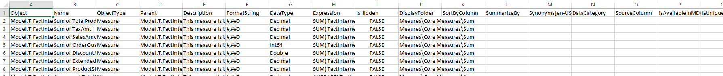
26
C# Advanced Scripting Editor
Script the data model
Extract all the model metadata. (17 columns)
What value does this add?
Shrikesh Pattni

Slide 36
27
C# Advanced Scripting Editor
Load VPAX Vertipaq Analyzer inside TE
What value does this add?
Shrikesh Pattni

Slide 37
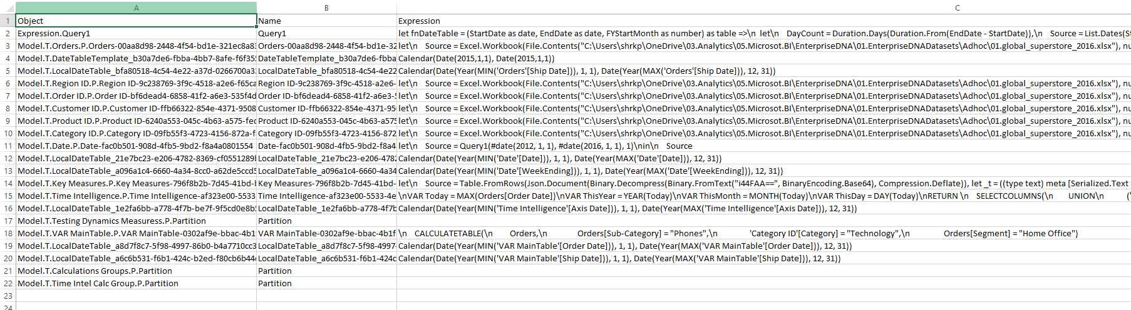
28
C# Advanced Scripting Editor
Load all queries, and M-Code inside a TSV file
What value does this add?
Shrikesh Pattni

Slide 38
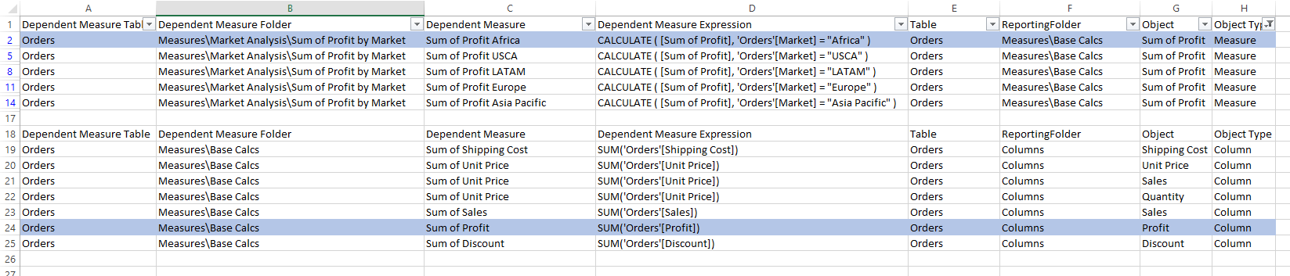
29
C# Advanced Scripting Editor
Create and show a dependency tree
based on all measures from sub-folder
What value does this add?
Shrikesh Pattni

Slide 39
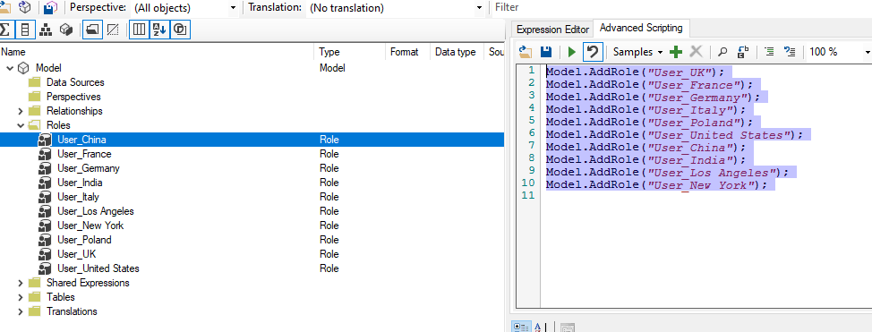
30
C# Advanced Scripting Editor
Create Row Level Security at Scale
What value does this add?
Shrikesh Pattni

Slide 40
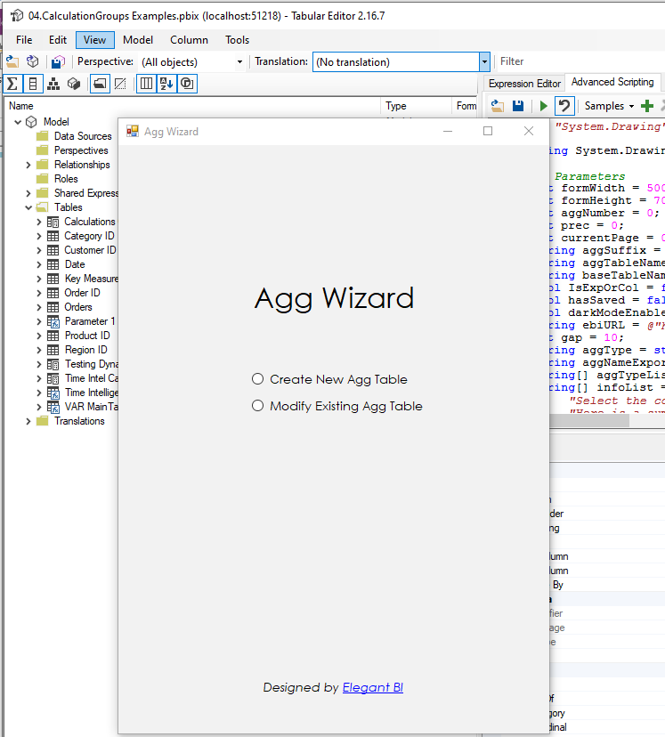
31
C# Advanced Scripting Editor
Create an Aggregation Wizard pop-up
What value does this add?
Useful in enterprise development, big datasets
Shrikesh Pattni

Slide 41
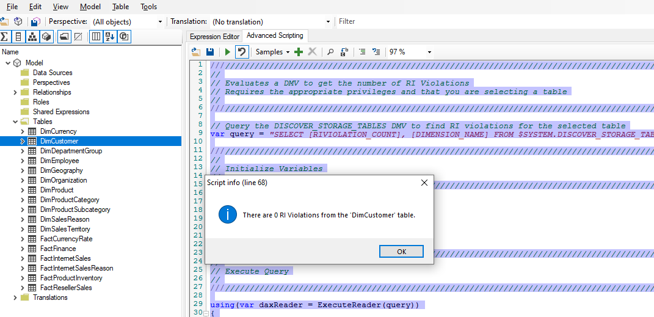
32
C# Advanced Scripting Editor
Check RI Violations on relationships
What value does this add?
Reduce the need to go into DAX Studios to check this
A more complete view of the model and potential errors
Shrikesh Pattni

Slide 42
33
C# Advanced Scripting Editor
Evaluate and check DAX Expressions
What value does this add?
A better way to understand filter/evaluation context
Shrikesh Pattni

Slide 43
34
C# Advanced Scripting Editor
Export all DMV’s from the model
What value does this add?
Full documentation/Data Governance on the model
Run a script to understand:
Calculated Columns
Calculated Tables
Calculated Items
Measures
Columns
6. Model Tables
7.Power Query Expressions
8. Power Query Expressions
Shrikesh Pattni

